Slide 1
Kochen-Specker Theorem in QIVPM

Slide 2
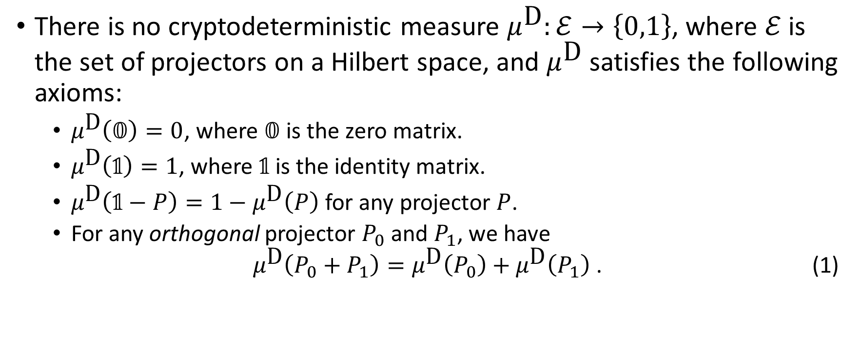
Kochen-Specker Theorem
There is no cryptodeterministic measure $μ^{\text{D}}:ℰ→\left\{0,1\right\}$, where $ℰ$ is the set of projectors on a Hilbert space, and $μ^{\text{D}}$ satisfies the following axioms:
$μ^{\text{D}}\left(𝟘\right)=0$, where $𝟘$ is the zero matrix.
$μ^{\text{D}}\left(𝟙\right)=1$, where $𝟙$ is the identity matrix.
$μ^{\text{D}}\left(𝟙−P\right)=1−μ^{\text{D}}\left(P\right)$ for any projector $P$.
For any orthogonal projector $P_{0}$ and $P_{1}$, we have $μ^{\text{D}}\left(P_{0}+P_{1}\right)=μ^{\text{D}}\left(P_{0}\right)+μ^{\text{D}}\left(P_{1}\right)$ . (1)

Slide 3
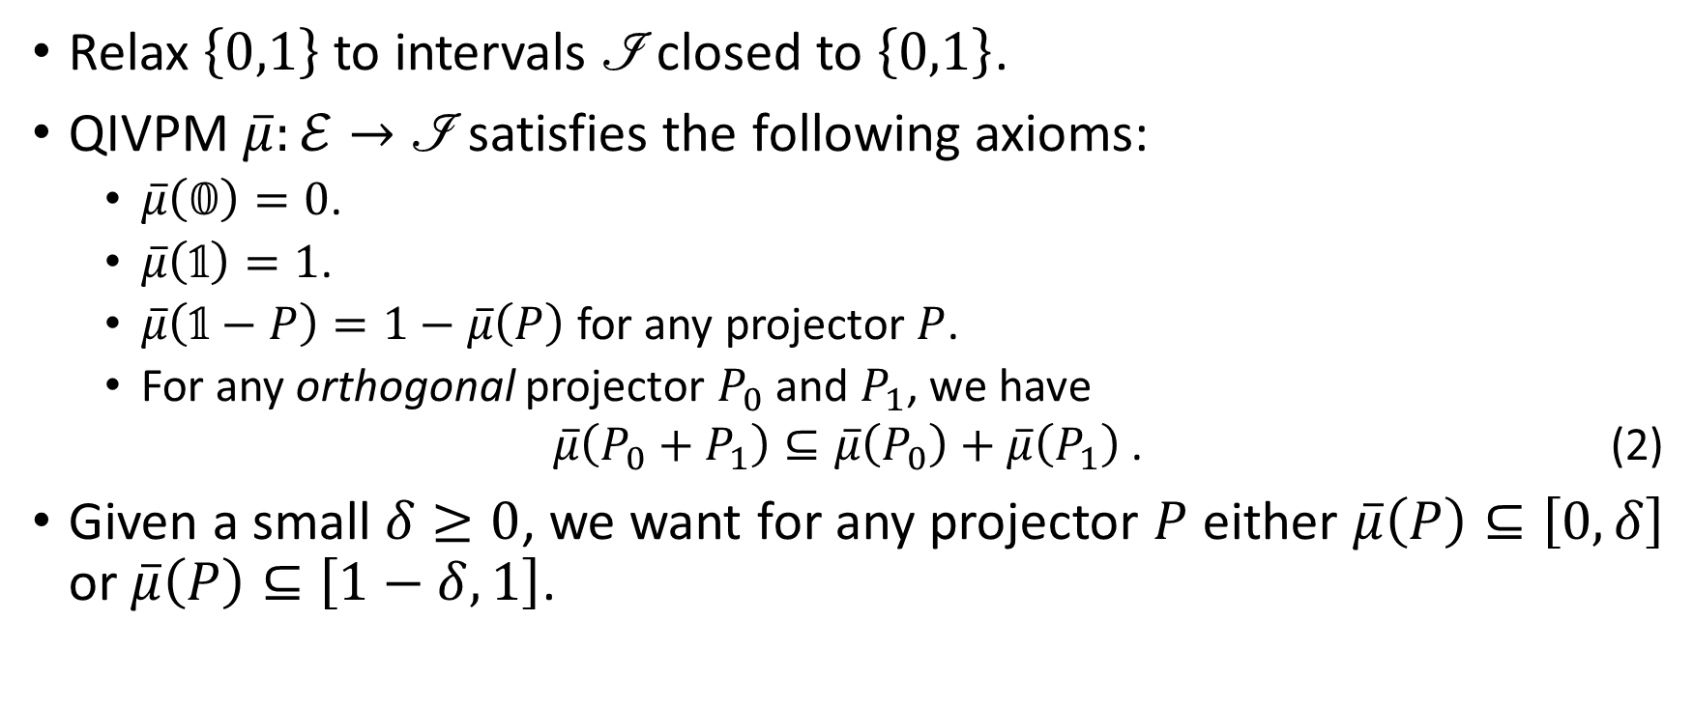
Finite Precision Measurement
Relax $\left\{0,1\right\}$ to intervals $\text{ℐ}$ closed to $\left\{0,1\right\}$.
QIVPM $\overline{μ}:ℰ→\text{ℐ}$ satisfies the following axioms:
$\overline{μ}\left(𝟘\right)=0$.
$\overline{μ}\left(𝟙\right)=1$.
$\overline{μ}\left(𝟙−P\right)=1−\overline{μ}\left(P\right)$ for any projector $P$.
For any orthogonal projector $P_{0}$ and $P_{1}$, we have $\overline{μ}\left(P_{0}+P_{1}\right)⊆\overline{μ}\left(P_{0}\right)+\overline{μ}\left(P_{1}\right)$ . (2)
Given a small $δ≥0$, we want for any projector $P$ either $\overline{μ}\left(P\right)⊆\left[0,δ\right]$ or $\overline{μ}\left(P\right)⊆\left[1−δ,1\right]$.
Notes:
XITS font is required to display Formal Script (\mathscr) font correctly.
https://www.ctan.org/tex-archive/fonts/xits/

Slide 4
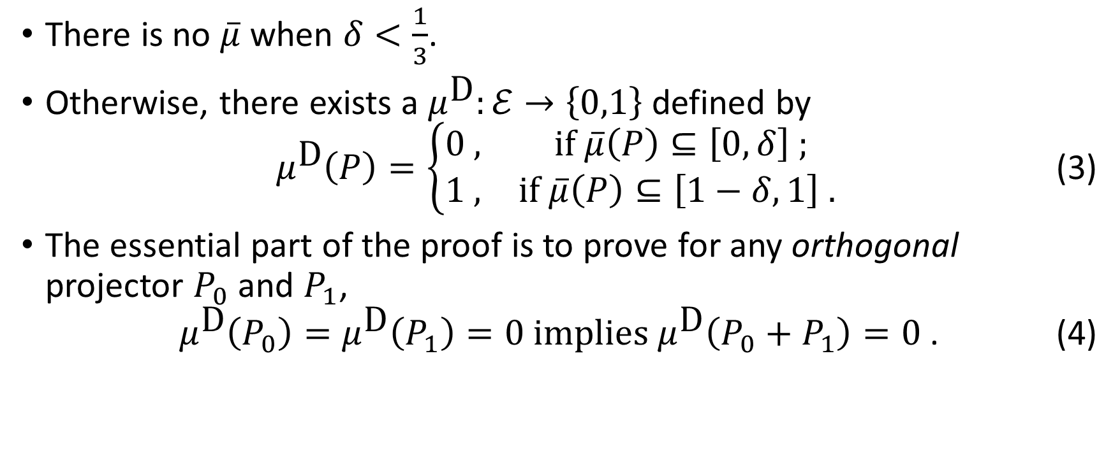
Kochen-Specker Theorem with Finite Precision Measurement
There is no $\overline{μ}$ when $δ<\frac{1}{3}$.
Otherwise, there exists a $μ^{\text{D}}:ℰ→\left\{0,1\right\}$ defined by $μ^{\text{D}}\left(P\right)=\left\{\begin{matrix}0\text{ ,} & \text{if} \overline{μ}\left(P\right)⊆\left[0,δ\right]\text{ ;} \\ 1 \text{,} & \text{if} \overline{μ}\left(P\right)⊆\left[1−δ,1\right]\text{ .}\end{matrix}\right.$ (3)
The essential part of the proof is to prove for any orthogonal projector $P_{0}$ and $P_{1}$, $μ^{\text{D}}\left(P_{0}\right)=μ^{\text{D}}\left(P_{1}\right)=0 \text{implies} μ^{\text{D}}\left(P_{0}+P_{1}\right)=0$ . (4)

Slide 5
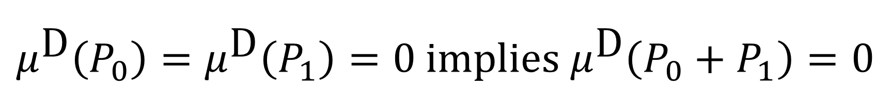
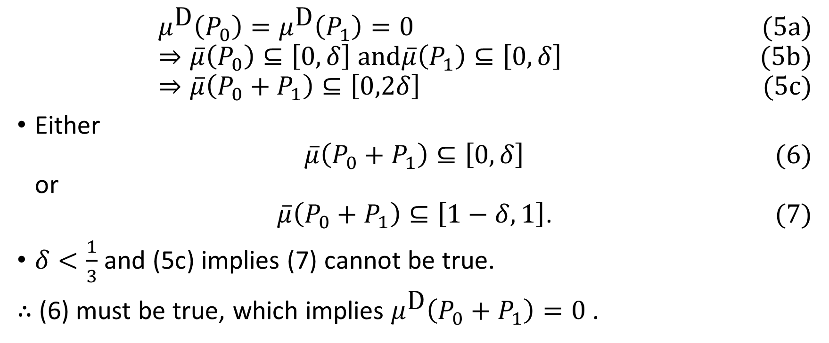
$$μ^{\text{D}}\left(P_{0}\right)=μ^{\text{D}}\left(P_{1}\right)=0 \text{implies} μ^{\text{D}}\left(P_{0}+P_{1}\right)=0$$
$μ^{\text{D}}\left(P_{0}\right)=μ^{\text{D}}\left(P_{1}\right)=0$ (5a) $⇒\overline{μ}\left(P_{0}\right)⊆\left[0,δ\right] \text{and}\overline{μ}\left(P_{1}\right)⊆\left[0,δ\right]$ (5b) $⇒\overline{μ}\left(P_{0}+P_{1}\right)⊆\left[0,2δ\right]$ (5c)
Either $\overline{μ}\left(P_{0}+P_{1}\right)⊆\left[0,δ\right]$ (6) or $\overline{μ}\left(P_{0}+P_{1}\right)⊆\left[1−δ,1\right]$. (7)
$δ<\frac{1}{3}$ and (5c) implies (7) cannot be true.
∴ (6) must be true, which implies $μ^{\text{D}}\left(P_{0}+P_{1}\right)=0$ .
Notes:
XITS font is required to display Formal Script (\mathscr) font correctly.
https://www.ctan.org/tex-archive/fonts/xits/

